Slide 1
Technical Advisory Council (TAC) Overview

Slide 2
Open Mainframe Project Overview and Governance

Slide 3





Vision
The mainframe is an active, integrated, and essential part of modern enterprise IT, consumable by mainstream developers and users, and driven by a vibrant open source community.
Mission
To achieve the vision of the Open Mainframe Project by…
The Open Mainframe Project was founded in 2015, as a focal point for deployment and use of Linux and Open Source in a mainframe computing environment.
Open Source is the collective thread within leading organizations that look to leverage their technology infrastructure as a competitive advantage. The mainframe design principles of security, stability, scalability, and performance are important to these leading organizations, and having the mainframe interoperable in a hybrid infrastructure enables leading organizations to realize its benefits. Open Mainframe Project believes this is best achieved as a community through open source.
Open Mainframe Project hosts 17 projects and working groups and is supported by 40 organizations.
Setting a high bar for application development on the mainframe
through documentation, API development, and a security-first approach.
Showcase the mainframe of today
to both the mainframe ecosystem as well as the broad enterprise IT community.
Enable the mainframe to be more consumable by developers
with a transparent experience in leveraging the value propositions of the mainframe.
Ensure the mainframe aligns well in the changing enterprise IT landscape
of cloud-native and DevOps.
Notes:
The mission of the Open Mainframe Project is to build that community and adoption of Open Source on the mainframe, which will ( read points above )
Image from https://www.openmainframeproject.org/about

Slide 4
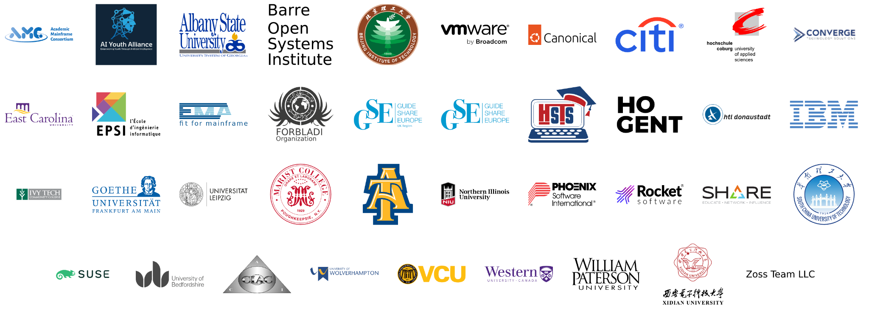
Member Organizations
Learn more about membership at openmainframeproject.org/join
Notes:
Source: https://landscape.openmainframeproject.org/embed/embed.html?base-path=&classify=category&key=open-mainframe-project-member-company&headers=false&category-header=true&category-in-subcategory=false&title-uppercase=false&title-alignment=center&title-font-family=sans-serif&title-font-size=13&style=clean&bg-color=%230033a1&fg-color=%23ffffff&item-modal=false&item-name=false&size=md&items-alignment=center

Slide 5
We’re a nonprofit, but not separately incorporated
The Open Mainframe Project is part of the the Linux Foundation and is not a separate legal entity
Therefore, the Open Mainframe Project Governing Board is not a corporate board of directors, and is not subject to corporate law statutes (e.g., those that govern fiduciary duties and how corporate boards of directors must operate)
The powers and duties of the Governing Board are set forth in the Open Mainframe Project Charter

Slide 6
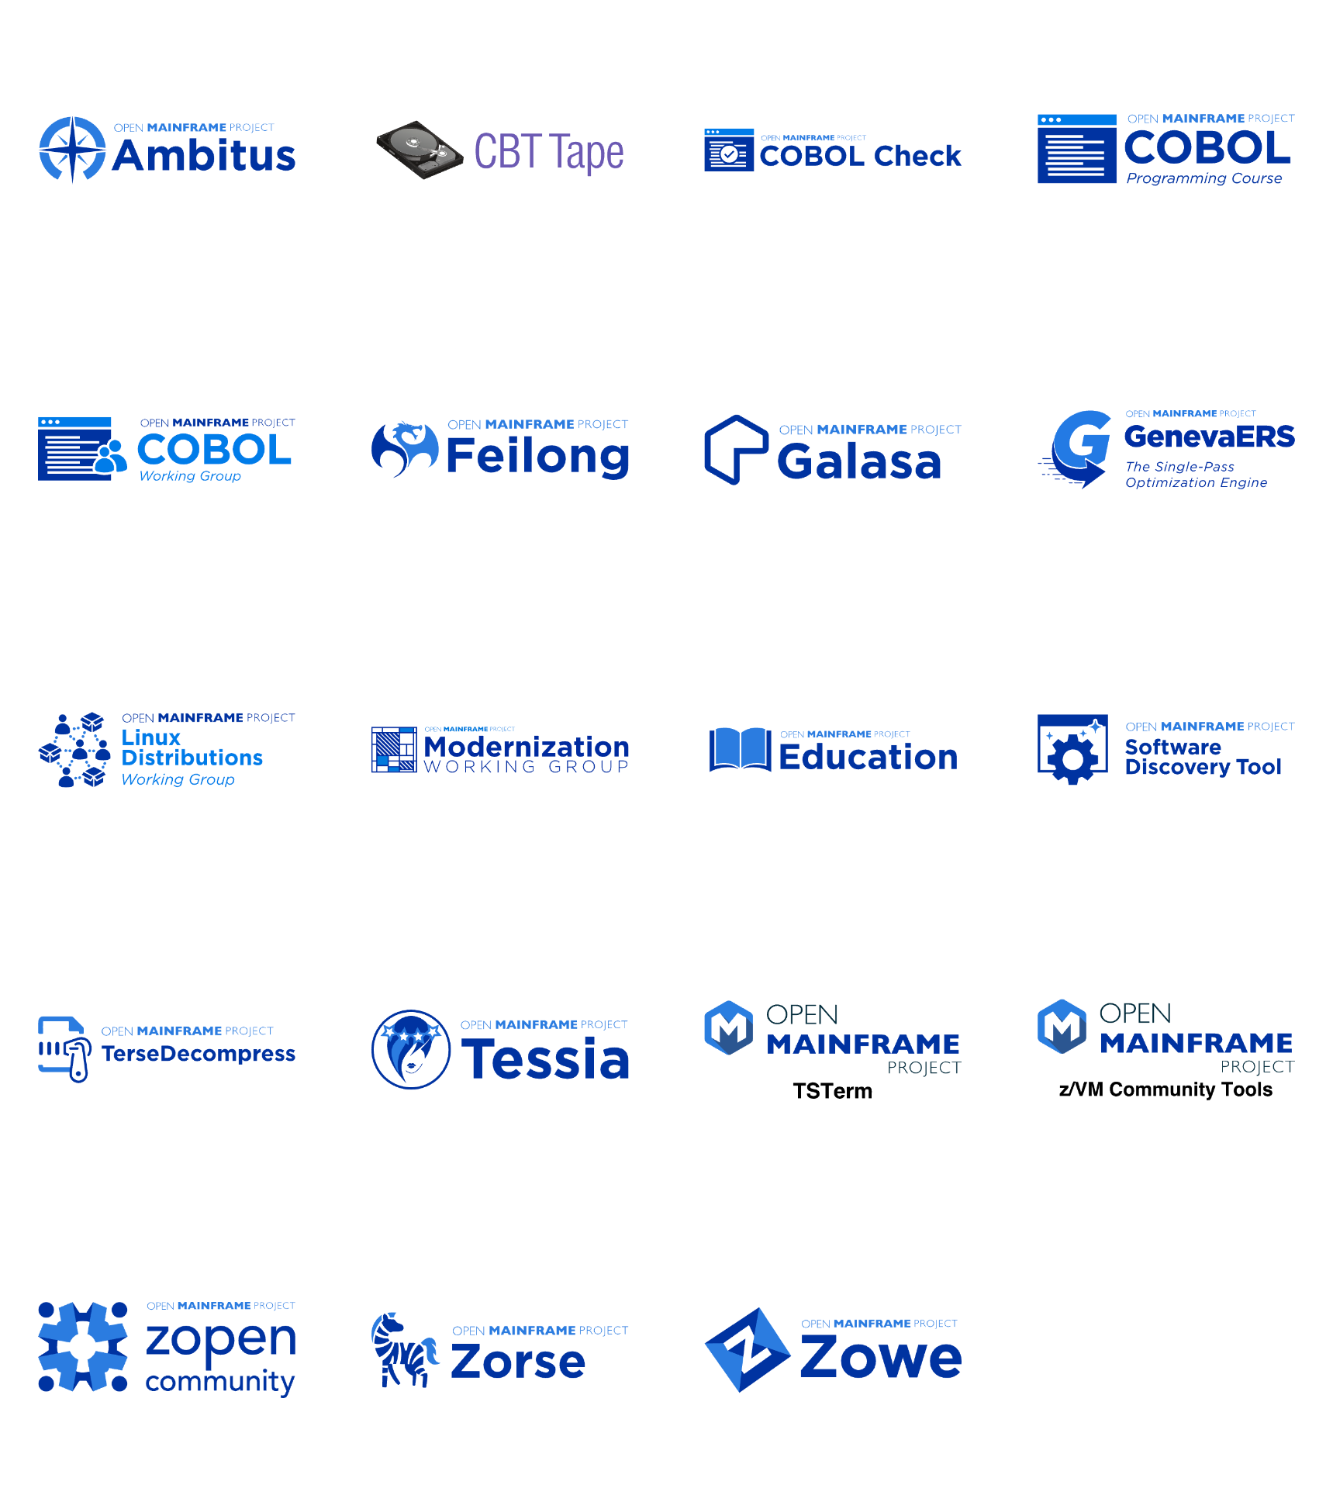
Open Mainframe Project enables this innovation
Learn about all Open Mainframe projects at https://openmainframeproject.org/our-projects/
Notes:
Open Mainframe Project enables this innovation as a host of 16 projects and working groups that are part of closing the gap.
Source: https://landscape.openmainframeproject.org/pages/hosted-projects?style=body{background-color:white;}.borderless-mode%20.mosaic%20.logo{height:100px;}.sh_wrapper%20span{font-size:24px!important;text-decoration:underline;color:black;}%23embedded-footer{display:none;}.borderless-mode%20.mosaic-wrap%20{%20padding:%200px%2010px;}

Slide 7
Open Mainframe Project Governance at a glance
Cross-project collaboration
Project Lifecycle Management
Developer Voice to GB
Technical Advisory Council (TAC)
Open Mainframe Project
Governing Board
Strategy & Priorities
Budget
Marketing Strategy & Events
Legal & overall governance
Marketing Committee
Zowe
ADE
Mentorship
Zorow
etc
Annual Marketing Plan
PR
Events
Content/Web
Branding
Market Development
Developer Communities
The Linux Foundation Internal Use Only

Slide 8
TAC Responsibilities

Slide 9
TAC Responsibilities
The TAC’s responsibilities include:
Setting an overall technical vision for Open Mainframe Project
Approving new projects and working groups;
Overseeing the Project Lifecycle;
Enabling collaboration between projects and working groups;
Making recommendations to the Budget Committee for any resource needs;
Voting on other decisions that come before the TAC.
Additional responsibilities are described in Section 4 of the Open Mainframe Project Charter.

Slide 10
What the TAC is NOT responsible for
The TAC does not manage the day-to-day activities and operations of hosted projects and working groups, such as committer rights, release schedules, and roadmaps.
The TAC is not responsible for overseeing day-to-day operations of Open Mainframe Project. This is the responsibility of the project staff.
The TAC does not directly manage the overall budget for the Open Mainframe Project. The TAC makes resource recommendations to the Budget Committee and Governing Board, and provides feedback on the use of those resources.

Slide 11
TAC Operations

Slide 12
TAC Composition
The TAC voting members consist of:
One representative appointed from each Platinum member and each Platinum End-User; and
One representative appointed by the TSC of each top-level project
See Section 4(a) of the LF Energy Foundation Charter for more information about composition.
You can change your representative at any time by making a request at members.openmainframeproject.org.

Slide 13
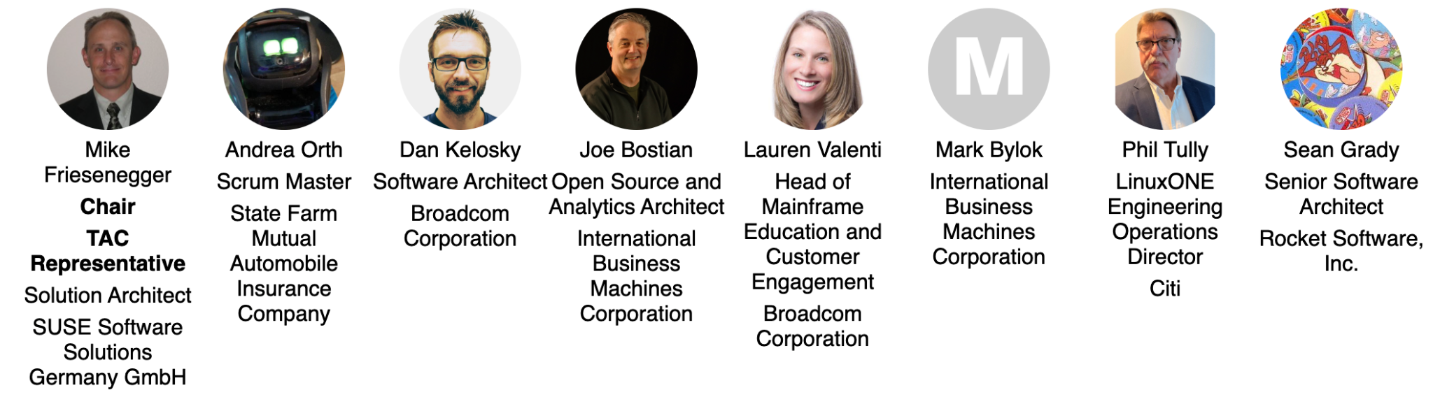
Technical Advisory Council (TAC) Representatives
Notes:
https://jmertic.github.io/committee-gallery/open-mainframe-project-tac

Slide 14
TAC Chairperson
Annually in December, the TAC will elect a chairperson to serve for the subsequent year. Duties of the TAC Chairperson include:
Leading the strategy for setting an overall technical vision for the Open Mainframe Project
Preparing the agenda for and leading TAC meetings, with the support of the project staff (generally meets with the staff on a regular basis to align on topics and priorities)
Serving as a voting member of the Governing Board to represent the TAC and larger technical communities.
Be a spokesperson for the TAC and larger technical community, as needed
See Section 4(e) of the Open Mainframe Project Charter for more information about the chairperson role.

Slide 15
TAC Meetings

Slide 16
Meeting Cadence
The TAC has virtual meetings, generally every on the second and fourth Thursday of the month. All meetings are public meetings unless specified otherwise.
Format for the meetings generally include short updates, and up to two larger topics ( such as an annual review of a project/working group, new project/working group proposal, larger discussion item, or special presentation )
Voting will often take place at each meeting
If you cannot attend a meeting and wish to have someone else represent you, please contact the project staff at members.openmainframeproject.org.
In rare and exceptional circumstances (e.g., in an emergency situation), an additional ad hoc special meeting of the TAC may be convened.
To request a special meeting, please email your request to the project staff and TAC Chair, and they will decide whether a special meeting is necessary or the proposed agenda item can be discussed by email or at the next regular meeting.

Slide 17
How to propose an agenda item
Agenda for TAC meetings are managed at https://github.com/orgs/openmainframeproject/projects/21
Propose a topic for a TAC meeting at https://github.com/openmainframeproject/tac/issues/new/choose
Please submit your proposed agenda item at least 7 days prior to the meeting.
Please be patient. TAC meeting agendas are often quite full, and the length of the meeting only allows the time for two larger topics per meeting, so if your topic is more than a short topic it may not scheduled for the next meeting.

Slide 18
Proposing an agenda item (continued)
If we cannot accommodate your request in the upcoming meeting we may:
Wait until the following meeting to discuss the topic
Call a special meeting to discuss your topic, or
Refer the topic to the appropriate committee or task force of the TAC
We may ask you to provide slides 3 days before the meeting.

Slide 19
TAC Materials
Agendas for TAC meetings will be made available the morning the scheduled meeting
Past meeting notes can be found here.
No meeting of the TAC is recorded unless the TAC provides explicit consent to do so.

Slide 20
Discussion Channels
Relevant Mailing Lists
Governing Board: omp-board@lists.openmainframeproject.org
TAC: omp-technical@lists.openmainframeproject.org
Budget Committee: omp-budget@lists.openmainframeproject.org
Slack Channel
You can join Open Mainframe Project slack here.
To join the Governing Board slack channel, make a request at members.openmainframeproject.org.

Slide 21
LFX Organization Dashboard
LFX Organization Dashboard provides access to key membership materials, including…
Member contacts, which you can change at any time ( look under ‘Users’ > and then under the ‘Key People’ tab )
Membership details ( look under ‘Membership’ > ‘Open Mainframe Project’ ), including…
Membership Overview Deck and High Level Overview Deck ( look under the ‘Resources’ tab )
Your fully executed membership agreement ( look under the ‘Membership’ tab )
Details on how to leverage membership benefits ( look under the ‘Benefits’ tab )
Insights on contributors from your organization ( look under the ‘Project Contributors’ tab )
ACTION: Request access to LFX Organizational Dashboard here.

Slide 22
Policies and Other Resources

Slide 23
Important Open Mainframe Project Policies and Resources
Open Mainframe Project Charter
Linux Foundation Antitrust Policy
Project GitHub repository with many other public facing policies and materials including…
Elections Process
Open Mainframe Project hosted project charters, which define each project’s intellectual property and licensing policies.
OMP Landscape
High Level Overview

Slide 24
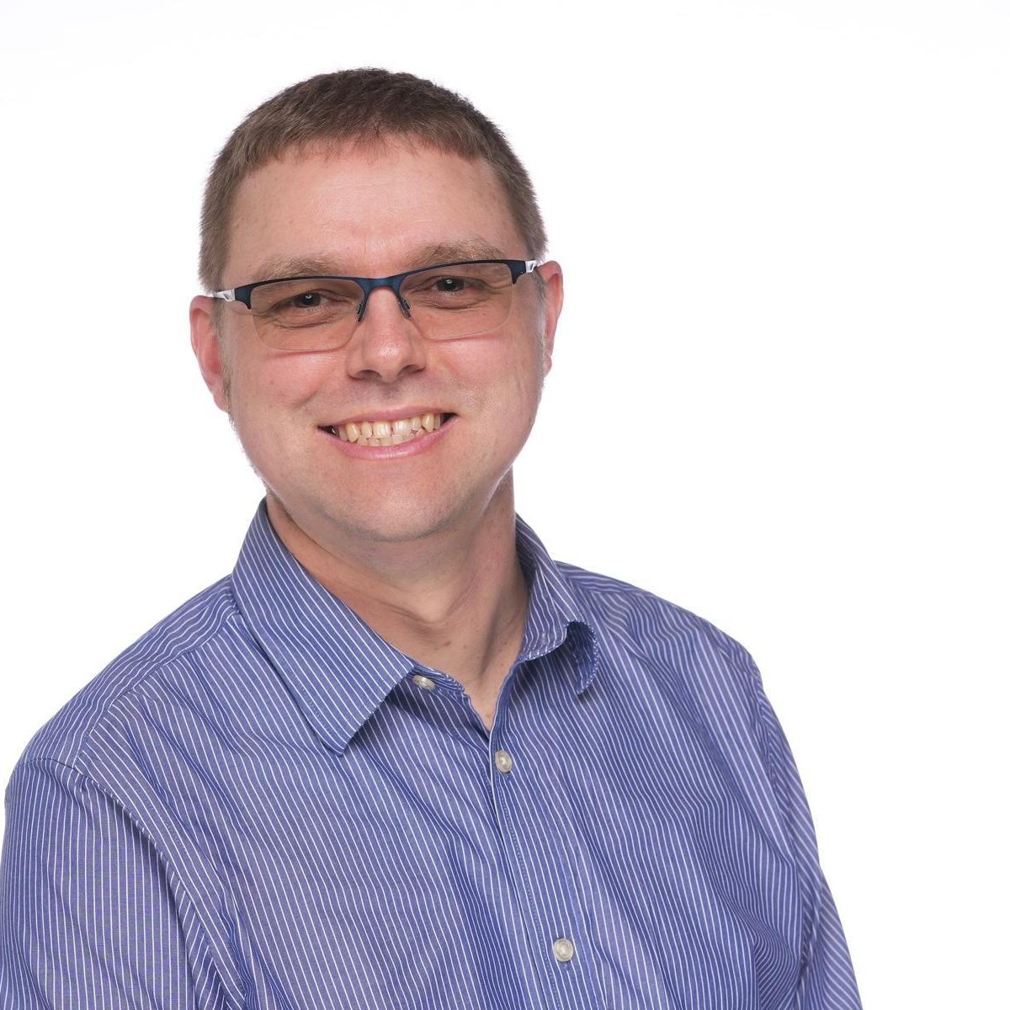
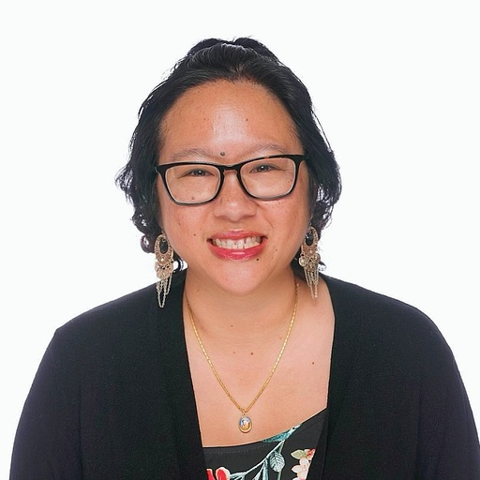
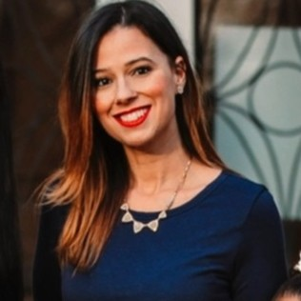
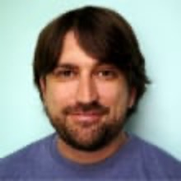

Open Mainframe Project staff
John Mertic, Executive Director
Maemalynn Meanor, Director of PR & Communications
Yarille Ortiz, Project Coordinator
Gary Schillinger, Podcast Producer
Deb Giles, Open Mainframe Summit and Events
Contact us at members.openmainframeproject.org

Slide 25
Who’s Who in the Academy Software Foundation
Open Mainframe Project Members
Staff: Open Mainframe Project Staff, Linux Foundation Leadership
Governing Board Members
Technical Advisory Council Members
Open Mainframe Project Project and Working Group Leads

Slide 26
Thank you!
If you have any questions, feel free to contact the staff at: members.openmainframeproject.org.

